Slide 1
Turing Machine
Computer based Machines for Automata

Slide 2
What is a computer?
computer
program
output
input
A computer is a machine that manipulates data according to a list of instructions.

Slide 3
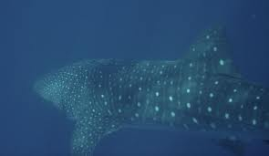
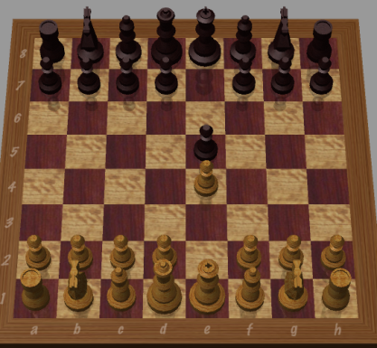

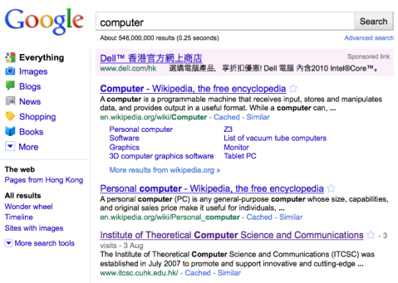
What is a computer?
void hello( String name)
{
print( “Hello, “, name);
}
?
Hello, world
deep blue
?
?

Slide 4
Turing Machines
control
head
a
b
b
☐
☐
…
input
blanks
Can both read from and write to the tape
Head can move both left and right
Tape is infinite
Has two special states accept and reject

Slide 5
Example
L₁ = {w#w: w ∈{a, b}*}
Strategy:
Read and remember the first symbol
abbaa#abbaa
Cross it off (x)
xbbaa#abbaa
Read the first symbol past #
xbbaa#abbaa
If they don’t match, reject
If they do, cross it off
xbbaa#xbbaa

Slide 6
Example
L₁ = {w#w: w ε{a, b}*}
Strategy:
Look for the first uncrossed symbol
xbbaa#xbbaa
Cross it off (x)
xxbaa#xbbaa
Read the first uncrossed symbol past #
xxbaa#xbbaa
If they match, cross it off, else reject
xxbaa#xxbaa
At the end, there should be only xs and #s
xxxxx#xxxxx
If not, reject; otherwise, accept.

Slide 7
How Turing Machines operate
current state
a/bL
q₁
q₂
…
a
b
a
☐
Replace a with b, and move head left
new state
a/bL
q₁
q₂
…
a
b
b
☐

Slide 8
Formal Definition
A Turing Machine is (Q, Σ, Γ, δ, q₀, ☐ ,F):
Q is a finite set of states;
Σ is the input alphabet not containing the blank symbol ☐
Γ is the tape alphabet (Σ ⊆ Γ) including ☐
☐ is the blank symbol
q₀ in Q is the start state;
F in Q are the accepting state
δ is the transition function
δ: Q × Γ→Q × Γ × {L, R}
Turing Machines are deterministic

Slide 9
Configurations
A configuration consists of the current state, the head position, and tape contents
configuration
q₁
abq₁a
a
b
a
☐
…
a/bR
q₁
q_{acc}
abbq_{acc}
q_{acc}
…
a
b
b
☐

Slide 10
Configurations
We say configuration C yields C’ if the TM can go from C to C’ in a single step
The start configuration of the TM on input w is q₀w
An accepting configuration is one that contains q_{acc}; A rejecting configuration is one that contains q_{rej}
abq₁a
yields
abbq_{acc}

Slide 11
The language of a Turing Machine
We say M accepts x if there exists a sequence of configurations C₀, C₁, ..., C_{k} where
C₀ is starting
C_{i} yields C_{i+1}
C_{k} is accepting
The language recognized by M is the set of all strings that M accepts

Slide 12
Looping
Something strange can happen in a Turing Machine:
Inputs can be divided into three types
☐/☐R
Σ = {0, 1}
q_{acc}
0/0R
input: ε
q₀
This machine never halts
1/1R
q_{rej}
q_{acc}
q_{rej}
accept
reject
loop

Slide 13
Halting
We say M halts on x if there exists a sequence of configurations C₀, C₁, ..., C_{k} where
C_{i} yields C_{i+1}
C_{k} is accepting
or rejecting
C₀ is starting
A TM M is a decider if it halts on every input
Language L is decidable if it is recognized by a TM that halts on every input

Slide 14
Programming Turing Machines
Description of Turing Machine:
L₁ = {w#w: w ∈{a, b}*}
1
Until you reach #
Read and remember entry
xbbaa#xbbaa
2
Write x
xxbaa#xbbaa
3
Move right past # and past all xs
xxbaa#xbbaa
4
5
If this entry is different, reject
Otherwise
6
Write x
xxbaa#xxbaa
7
Move left past # and to right of first x
xxbaa#xxbaa
8
If you see only xs followed by ☐, accept

Slide 15
Programming Turing Machines
a/aR
b/bR
x/xR
L₁ = {w#w: w ∈{a, b}*}
q_{a1}
#/#R
q_{a2}
a/aL
b/bL
a/aL
4
a/xL
b/bL
3
x/xL
2
x/xR
a/xR
5
6
#/#L
q₀
#/#R
q₁
☐/☐R
q_{acc}
q₂
q₃
q_{rej}
1
8
b/xR
6
7
b/xL
5
2
everything else
3
q_{b1}
4
q_{b2}
#/#R
a/aR
x/xR
b/bR
x/xR

Slide 16
Programming Turing Machines
a/aR
b/bR
input: aab#aab
x/xR
configurations:
q_{a1}
#/#R
q_{a2}
a/aL
q₀aab#aab
b/bL
a/aL
4
a/xL
b/bL
xq_{a1}ab#aab
3
x/xL
2
x/xR
a/xR
5
xaq_{a1}b#aab
6
#/#L
q₀
#/#R
q₁
☐/☐R
q_{acc}
q₂
q₃
1
8
xabq_{a1}#aab
b/xR
6
7
b/xL
5
xab#q_{a2}aab
2
3
xabq₂#xab
q_{b1}
4
q_{b2}
#/#R
xaq₃b#xab
a/aR
x/xR
xq₃ab#xab
b/bR
q₃xab#xab
x/xR
xq₀ab#xab

Slide 17
How to describe Turing Machines?
Unlike for DFAs, NFAs, PDAs, we rarely give complete state diagrams of Turing Machines
Usually we give a high-level description: A recipe about the workings of the Turing Machine
Just like in cooking, practice makes perfect!

Slide 18
Programming Turing Machines
L₄ = {〈G〉: G is a connected undirected graph}
Q: How do we feed a graph into a Turing Machine?
A: We represent it by a string, e.g.
(1,2,3,4)((1,4),(2,3),(3,4)(4,2))
1
2
Convention for describing graphs:
(nodes)(edges)
3
4
no node must repeat
edges are pairs (node₁,node₂)

Slide 19
Programming Turing Machines
L₄ = {〈G〉: G is a connected undirected graph}
On input 〈G〉,
0.
Verify that 〈G〉 is the description of a graph
(no vertex repeats; edges only go between nodes)
1.
Mark the first node of G
x
x
1
2
2.
Repeat until no new nodes are marked:
For each node, mark it if it is attached to an already marked node
x
x
3
4
3.
If all nodes are marked accept, otherwise reject.

Slide 20
Programming Turing Machines
L₄ = {〈G〉: G is a connected undirected graph}
(1,2,3,4)((1,4)(2,3)(3,4)(4,2))
•
(1,2,3,4)((1,4)(2,3)(3,4)(4,2))
•
(1,2,3,4)((1,4)(2,3)(3,4)(4,2))
•
(1,2,3,4)((1,4)(2,3)(3,4)(4,2))
1
2
•
•
(1,2,3,4)((1,4)(2,3)(3,4)(4,2))
•
•
(1,2,3,4)((1,4)(2,3)(3,4)(4,2))
•
•
3
4
(1,2,3,4)((1,4)(2,3)(3,4)(4,2))
•
•
(1,2,3,4)((1,4)(2,3)(3,4)(4,2))
•
•
(1,2,3,4)((1,4)(2,3)(3,4)(4,2))
•
•
(1,2,3,4)((1,4)(2,3)(3,4)(4,2))
etc.
•
•
•

Slide 21
Turing machines
What’s so great about
Turing Machines?

Slide 22
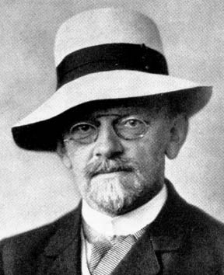
Hilbert’s list of 23 problems
Leading mathematician in the 1900s
At the 1900 International Congress of Mathematicians, proposed a list of 23 problems for the 20th century
Hilbert’s 10th problem:
David Hilbert
(1862-1943)
Find a method to tell if an equation like xyz – 3xy + 6xz + 2 = 0 has integer solutions

Slide 23
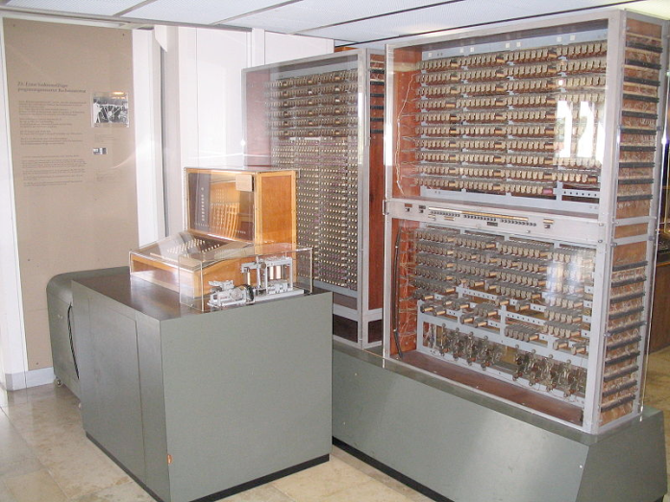
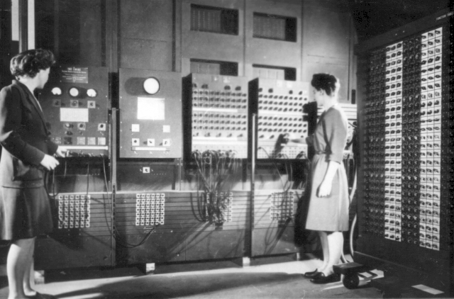


A brief history of computing devices
Z3 (Germany, 1941)
ENIAC (Pennsylvania, 1945)
PC (1980)
MacBook Air (2008)

Slide 24

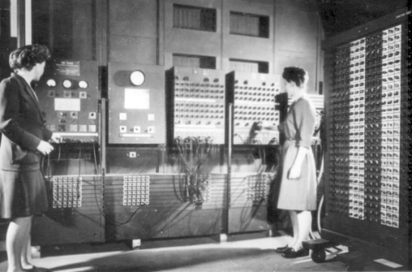
Computation is universal
In principle, all these
have the same problem-solving ability

Slide 25
The Church-Turing Thesis
Turing Machine
If an algorithm can be implemented on any realistic computer, then it can be implemented on a Turing Machine.

Slide 26

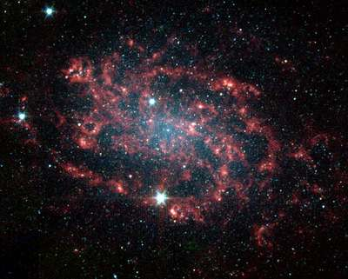
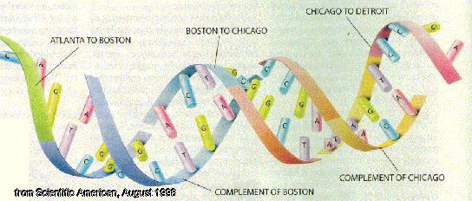
The Church-Turing Thesis
Turing Machine
quantum computing
cosmic computing
DNA computing

Slide 27
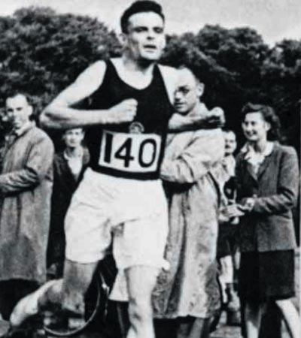
Alan Turing
Invented the Turing Test to tell humans and computers apart
Broke German encryption machines in World War II
The Turing Award is the “Nobel prize of Computer Science”
Alan Turing
(1912-1954)
Turing’s motivation: By studying Turing Machines, we can understand the limitations of real computers.

Slide 28
Undecidability
What Hilbert meant to ask was:
Building on work of Gödel, Church, Turing, Davis, Putnam, Robinson, in 1970 Matijasievič showed:
Find a Turing Machine to tell if an equation like xyz – 3xy + 6xz + 2 = 0 has integer solutions
There is no such Turing Machine!

Slide 29
Computer program analysis
public static void main(String args[]) { System.out.println("Hello World!");
}
What does this program do?
public static void main(String args[]) {
int i = 0;
for (j = 1; j < 10; j++) {
i += j;
if (i == 28) {
System.out.println("Hello World!");
}
}
}
How about this one?

Slide 30
Computers cannot analyze programs!
No Turing Machine can do this:
input: The code of a java program P
Accept if P prints “hello, world”
Reject if not
Significance: It is impossible for computer to predict what a computer program will do!

